Slide 1


Slide 2
Subject: Capstone Project- Planning (CPP) Topic: Smart Traffic control System For Ambulance Guide: Mrs. Mane Mam
Government Polytechnic Solapur
Submited by:
 | Roll No | Enrollment NO | Name
 | 97 | 2100150060 | Sanskruti Waghmare
 | 99 | 2100150077 | Akanksha Survase
 | 87 | 2100150005 | Ranjeeta Arikiri
 | 92 | 2100150024 | Sanika Sutar
91 |  | 2100150023 | Vaishnavi Chitbone

Slide 3
Smart Traffic control System For Ambulance
Problem Statement :
"In urban areas, traffic congestion poses a significant challenge to emergency response services, notably ambulances, delaying their arrival at critical medical situations. Existing traffic management systems lack the capability to prioritize ambulance routes effectively, resulting in potentially life-threatening delays. Thus, there is a pressing need for a Smart Traffic Control System tailored specifically for ambulances, capable of dynamically optimizing traffic flow to ensure swift and unimpeded access to medical emergencies. This system aims to mitigate the adverse effects of traffic congestion on ambulance response times, thereby enhancing the overall efficiency of emergency medical services and potentially saving lives."

Slide 4

Introduction : In urban areas worldwide, traffic congestion remains a persistent challenge, often impeding the swift response of emergency medical services, particularly ambulances, to critical situations. Recognizing the critical need for efficient traffic management in emergency response scenarios, this paper presents the design and development of a Smart Traffic Control System tailored specifically for ambulances. Leveraging advancements in web technologies, including HTML, CSS, JavaScript, and PHP, this system aims to prioritize ambulance routes by dynamically optimizing traffic flow in real-time.

Slide 5
Software/hardware requirements
1 | IDE | Notepad++,VS Code
2 | Operating System | Microsoft Windows 11
3 | System Type | 64-bit Operating System
4 | Frontend | HTML,CSS,Javascript
5 | Backend | PHP MYSQL
6 | IDE | Notepad++
Sr. No. | Resource | Broad Specifications
1 | Processor | Intel core i5
2 | Graphics | On board graphics card (NVIDIA)
3 | RAM | 8 GB
4 | Storage | 512 GB SSD

Slide 6
Objectives : 1. Optimize ambulance response times. 2. Enhance emergency medical services. 3. Minimize patient risk. 4. Utilize real-time data for traffic management. 5. Ensure safety and reliability. 6. Collaborate with stakeholders. 7. Implement continuous improvement. 8. Develop a cost-effective solution. 9. Ensure compliance with regulations. 10. Raise public awareness and education.

Slide 7
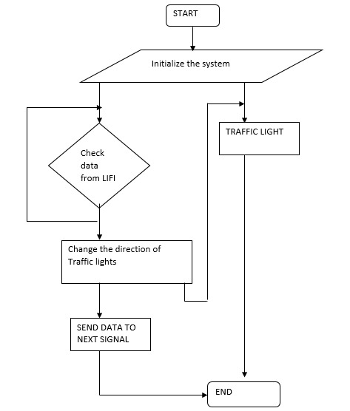
DIAGRAMS : Flow chart :

Slide 8
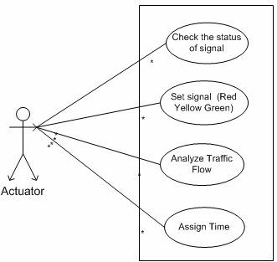
Use Case Diagram :

Slide 9
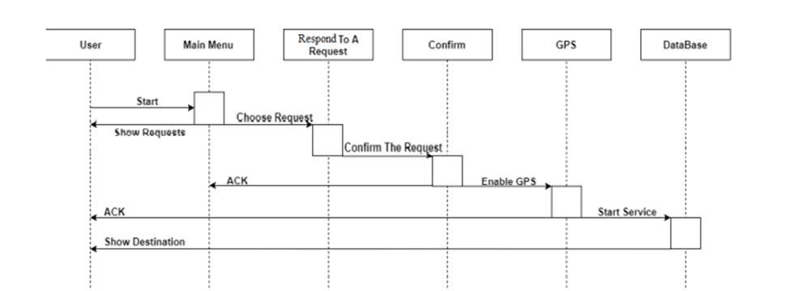
Class Diagram :

Slide 10
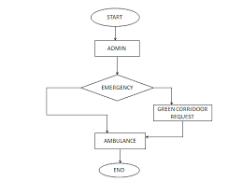
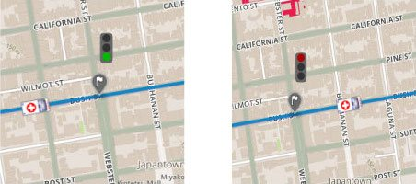
DFD Diagram :

Slide 11
1. Languages / Tools Used: - HTML: Markup language for structuring the user interface of the system. - CSS: Styling language for designing the appearance and layout of web pages. - JavaScript (JS): Programming language for adding interactivity and dynamic features to the user interface. - PHP: Server-side scripting language for handling backend logic, database interactions, and server-side processing.

Slide 12
2. How software Works : The software works by integrating real-time traffic data and ambulance locations to dynamically optimize traffic flow in urban areas. It continuously monitors traffic conditions and receives emergency calls from dispatch centers. When an emergency call is received, the system prioritizes ambulance routes based on current traffic conditions and adjusts traffic signals accordingly to provide green corridors for ambulances. System administrators can configure settings, monitor traffic data, generate reports, and handle errors through the admin module. Users, including emergency responders and traffic management authorities, interact with the system through a user-friendly interface to ensure swift and efficient emergency response operations.

Slide 13
2. Important Modules: User Interface Module: Responsible for creating the frontend components using HTML, CSS, and JavaScript, ensuring a visually appealing and interactive interface for users. Traffic Data Collection Module: Collects real-time traffic data from sensors and cameras, and processes it for further analysis and decision-making. Admin Module : 1. Manage users, roles, and permissions. 2. Configure traffic signal settings and emergency response policies. 3. Monitor real-time traffic data and ambulance locations. 4. Generate reports and analyze system performance. 5. Handle errors and log system events. 6. Perform system maintenance tasks. 7. Communicate internally and collaborate with external agencies. 8. Enforce security measures and access control.

Slide 14
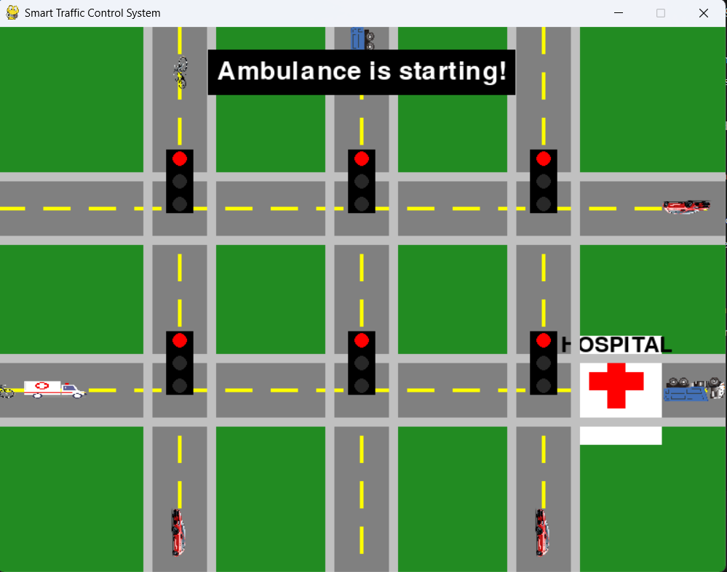
3.Output :

Slide 15
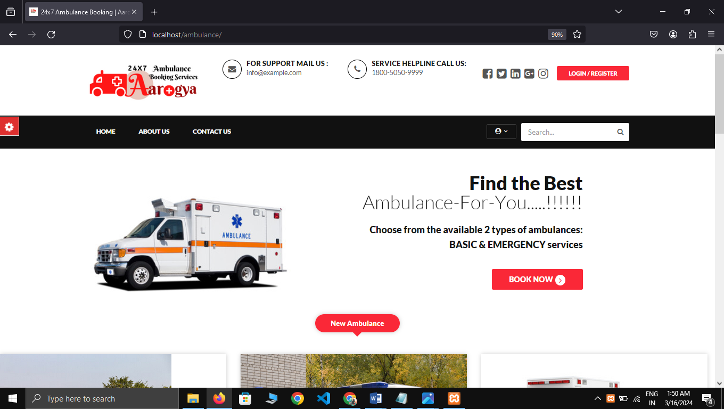

Slide 16
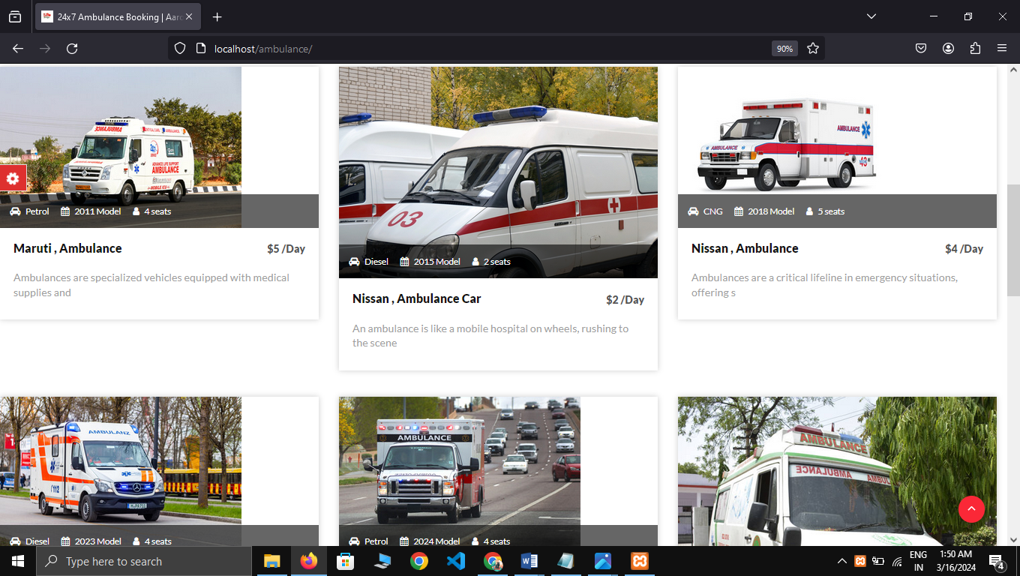

Slide 17
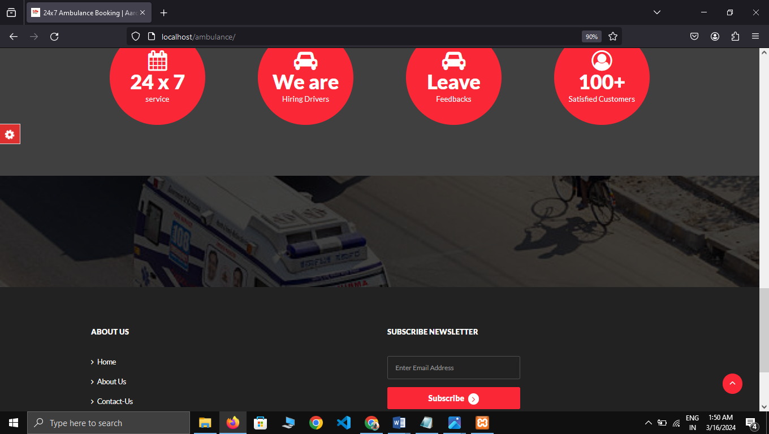

Slide 18
Future Scope : The future scope of this project includes integrating with broader smart city initiatives, incorporating machine learning and AI for predictive traffic management, developing a mobile application for citizen engagement, and implementing advanced routing algorithms for emergency vehicles. Additionally, there's a potential to enhance data analytics capabilities, integrate with autonomous vehicles, and introduce geofencing for dynamic traffic zones. Community engagement efforts and cross-platform compatibility will be essential, along with global deployment and collaboration to share best practices and insights for improved emergency response and urban traffic management on a larger scale.

Slide 19
Conclusion :
In conclusion, the Smart Traffic Control System developed using HTML, CSS, JavaScript, and PHP demonstrates significant improvements in ambulance response times and traffic management efficiency. Through thorough testing, the system has been validated to effectively prioritize ambulance routes, adjust traffic signals in real-time, and handle emergency scenarios with reliability and accuracy. User feedback from acceptance testing has been positive, indicating satisfaction with the system's functionality and usability. Additionally, performance and security testing have confirmed the system's robustness and resilience under various conditions. Overall, the Smart Traffic Control System represents a critical advancement in emergency response technology, contributing to enhanced public safety and emergency medical services.

Slide 20
References :
[1] W3Schools. (n.d.). HTML Tutorial. Retrieved from https://www.w3schools.com/html/
[2] Mozilla Developer Network. (n.d.). CSS (Cascading Style Sheets). Retrieved from https://developer.mozilla.org/en-US/docs/Web/CSS
[3] JavaScript. (n.d.). JavaScript | MDN. Retrieved from https://developer.mozilla.org/en-US/docs/Web/JavaScript
[4] PHP: Hypertext Preprocessor. (n.d.). PHP: Hypertext Preprocessor. Retrieved from https://www.php.net/
[5] Apache Software Foundation. (n.d.). MySQL :: MySQL Documentation. Retrieved from https://dev.mysql.com/doc/
[6] GitHub. (n.d.). GitHub: Where the world builds software. Retrieved from https://github.com/

Slide 21


